Slide 1
Writing Evidence-Based Claims
Ms. Ritchie
10-22-19

Slide 2
You are improving on making your claims.
You have been practicing writing claims that are based on evidence.
You state a claim, then back it up with evidence.

Slide 3
Next steps
Give some context.
Incorporate your claims properly.
Show your thinking. How did you get to your claim from the evidence?

Slide 4
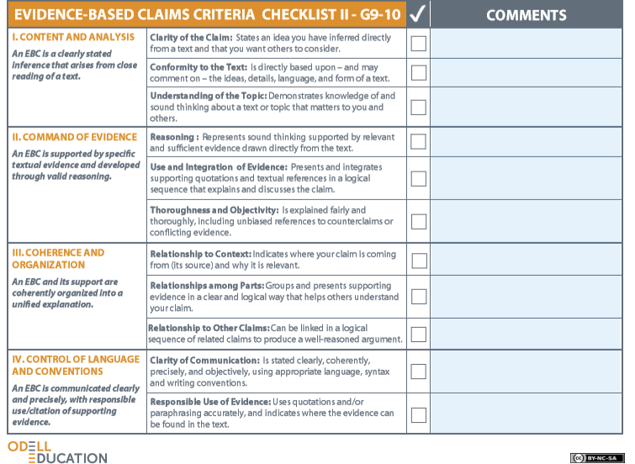
Checklist

Slide 5
Essay Structure
Paragraph 1: Claim + Context
Paragraphs 2-?: Develop points of the claim in logical order. Present and explain evidence.
Last Paragraph: Conclusion = Restate the claim and why you were right about it.

Slide 6
Incorporating Textual Evidence
There are lots of different ways you can present your evidence.
For now if you are stumped, try this:
  In line _____ of Apology, Socrates says, “Blah blah blah blah.”
    (Don’t write “blah blah blah.” Write the thing he said.)
    You should still sound like yourself when writing an essay.

Slide 7
Quote or Paraphrase?
Quote a piece of evidence when:
  It’s a powerful phrase
  The author’s words are better than what you could do
  It’s a relatively short quote.
Paraphrase a piece of evidence when:
  The evidence is more than 2 sentences long.
  The author’s voice isn’t that strong in that part.
  It’s a minor supporting detail.

Slide 8
Assignment
By yourself or in pairs, write a draft of an essay using your claim.
  Use your outline and/or your Organizing EBCs Worksheet as a guide.
  This is just a draft. We will add more later. For now, just worry about getting down in essay form what you have in your organizer.
  Open a new Google Doc and submit it through the class Web site on today’s date on the Assignments page.
    Be sure your name is on the document.

